Slide 1

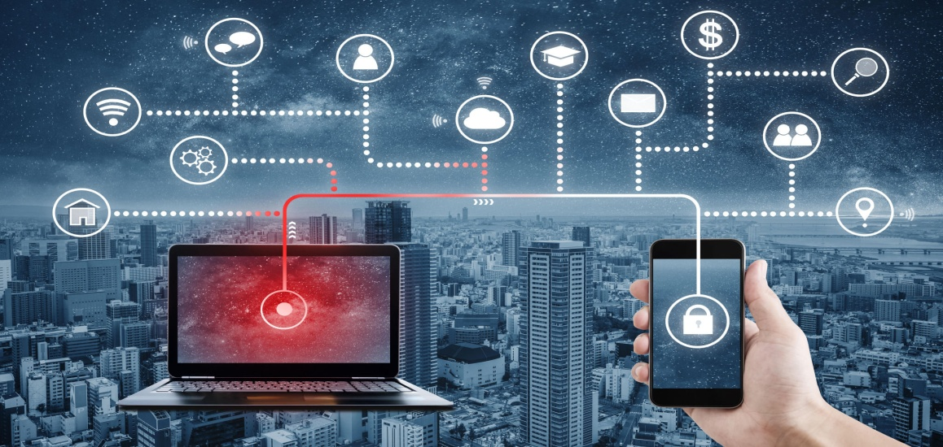
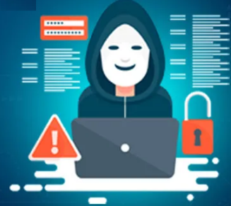
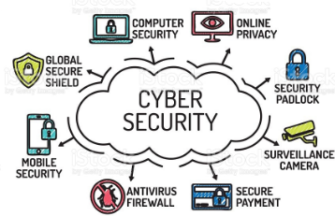
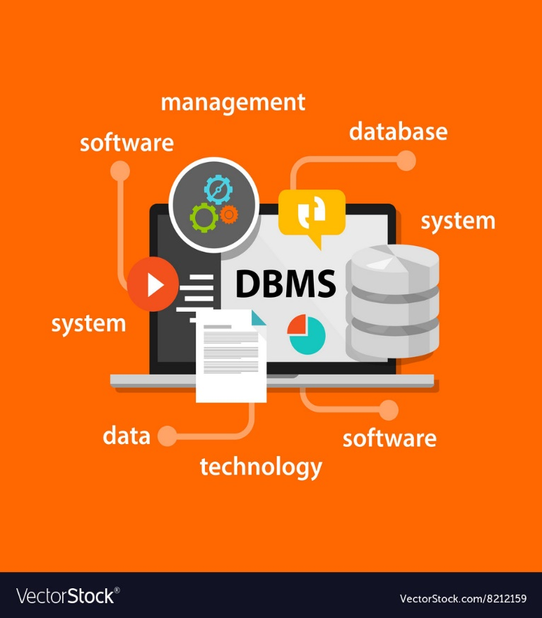

Cyber security
Unit-3
Cybercrime: Mobile and Wireless Devices
Dr.H.BALAJI
9666444100
halavathbalaji@sreenidhi.edu.in
SREENIDHI INSTITUTE OF SCIENCE & TECHNOLOGYY
YAMNAMPET, GHATKESAR 501 301, RANGA REDDY DIST.

Slide 2
Cybercrime: Mobile and Wireless Devices
Introduction
Proliferation of Mobile and Wireless Devices
Trends in Mobility
Credit card Frauds in Mobile and Wireless Computing Era
Security Challenges Posed by Mobile Devices
Registry Settings for Mobile Devices
Authentication service Security
Attacks on Mobile/Cell Phones
Mobile Devices: Security Implications for Organizations Organizational Measures for Handling Mobile
Organizational Security Policies and Measures in Mobile Computing Era
Laptops and desktop.

Slide 3
What is a Mobile Device/Wireless?
Mobile Device: a device that is easy to use, enables remote access to business networks and the internet, and enables quick transfer of data.
Wireless Communication: the transfer of information over a distance without the use of electrical conductors or wires

Slide 4
What are some examples of Mobile Devices?
Laptops
Cell Phones
PDAs
Flash Drives
Bluetooth
Mouse/Keyboard
Mp3 Players
Garage Door Opener
GPS
Cordless phone
Cameras
Graphing Calculator
Nintendo Wii (game controllers)

Slide 5
How does Wireless Work?
Wireless networks use electromagnetic radiation as their means of transmitting data through space.
An access point (AP) device is physically connected to the LAN (typically a router)
The AP has an antenna and sends and receives data packets through space
A wireless device then connects to the WLAN using its transmitter to connect to the AP, and then to the LAN.

Slide 6
Growing Popularity
Used for day to day activities
Affordable
Necessary to keep up with competitors using the same technology
Convenient Size

Slide 7
Proliferation of Mobile and Wireless Devices
PC: Portable Computer
Tablet PC: notebook , with stylus
Internet tablet: limited applicatio suite, has MP#, Web Browser, chat application, picture viewer
PDA : Pocket held and portable computer
Ultra mobile PC: PDA installed with General OS
Smartphone
Carputer : Installed in automobile , for GPS, and Bluetooth compatible
Fly Fusion Pen top Computer : size and shape of a pen used as a language translator and storage device.

Slide 8
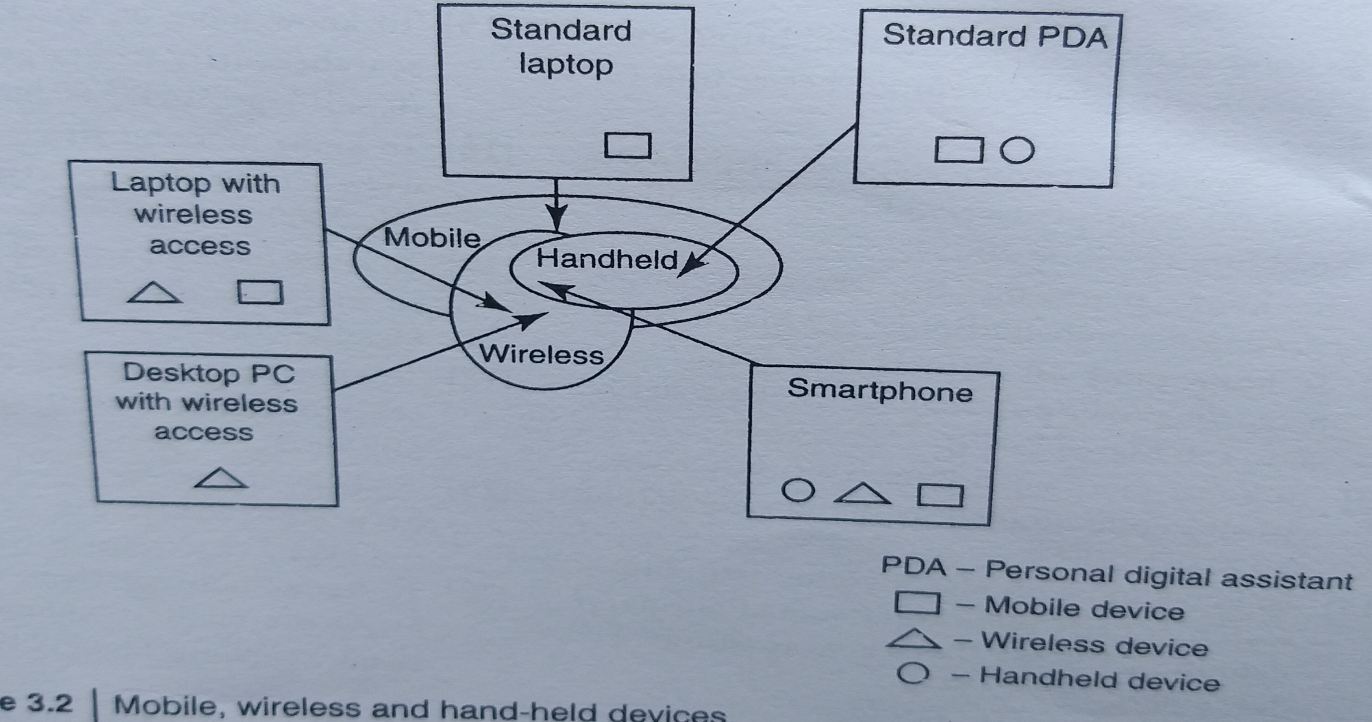
Mobile and Hand Held Devices

Slide 9
Trends In Mobolity
Mobile computing is moving into a new era, third generation 3G and 4G, which promises greater variety in
applications and have highly improved usability as well as speedier networking. "iPhone" from Apple and
Google-led "Android" phones .
This smart mobile technology is rapidly gaining popularity and the attackers (hackers and crackers) are among its biggest fans.

Slide 10
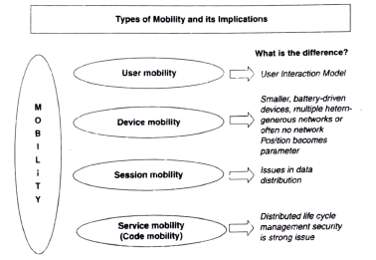

Slide 11

Popular types of attacks against 3G mobile networks
Malware, viruses and worms
  Skull trojans
  Cabir worm
  Mosquito worm
  Brador Torjan
  Lasco Worm
Denial-of-service: Unavailability of network , JAMMIMG or Flooding
Overbilling attack: Hijack users ID for extorting Charges
Spoofed policy development process: Attacks pertaining to Gen. Packet Radio Service Tunneling protocol
Signaling-level attacks: Attacks on VOIP, Internet Multimedia subsystems

Slide 12
Skull trojan
A trojan horse piece of code that targets mainly Symbian OS. Once downloaded, the virus replaces all phone desktop icons with images of a skull. It also renders all phone applications useless. This malware also tends to mass text messages containing malicious links to all contacts accessible through the device in order to spread the damage. This mass texting can also give rise to high expenses.

Slide 13
Cabir worm
This malware infects mobile phones running on Symbian OS and was first identified in June 2004. When a phone is infected, the message 'Caribe' is displayed on the phone's screen and is displayed every time the phone is turned on. The worm then attempts to spread to other phones in the area using wireless Bluetooth signals, although the recipient has to confirm this manually.

Slide 14
Mosquito worm
In June 2004, it was discovered that a company called Ojam had engineered an anti-piracy Tro jan virus in older versions of its mobile phone game, Mosquito.
This virus sent SMS text messages to the company without the user's knowledge.
Although this malware was removed from the game's more recent versions, it still exists in older, unlicensed versions, and these may still be distributed on file- sharing networks and free software download web sites.

Slide 15
Brador Trojan and Lasco Worm
Brador Trojan : Brador is the first known backdoor for the Pocket PC hand-held devices. When run, the backdoor copies itself to startup folder, mails the IP address of the PDA to the backdoor author and starts listening commands on a TCP port. ... Brador is a backdoor, not a virus.
Lasco Worm :A worm that spreads over Bluetooth networks and mobile phones run on Symbian OS.

Slide 16
List Of Mobile Vulnerabilities
Mobile devices often do not have passwords enabled.
Two-factor authentication is not always used when conducting sensitive transactions on mobile devices.
W ire le s s transmissions are not always encrypted
Mobile devices may contain malware.
Mobile devices often do not use security software.
Operating systems may be out-of-date.
Software on mobile devices may be out-of-date
Mobile devices often do not limit Internet connections.
Mobile devices may have unauthorized modifications.
an unsecured WiFi network could let an attacker access personal information from a device, putting users at risk for data and identity theft.

Slide 17
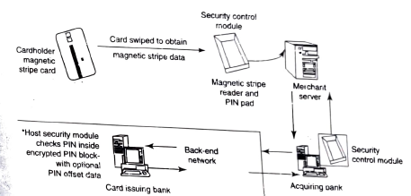
Credit card Processing systems and Frauds

Slide 18
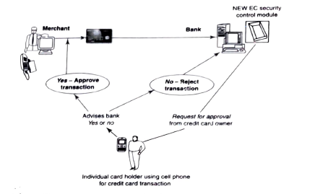
Credit card Processing systems and Frauds

Slide 19
Credit card Processing systems and Frauds
Types of Credit card Frauds
- Stolen or fake documents
- Application Frauds A. ID Thefts B Financial Frauds through false Information
Modern Techniques
1.Triangulation Tech -Triangulation fraud works by placing the fraudster as a middleman between a customer and an unsuspecting merchant. The customer places the order through the fraudster, then the fraudster uses stolen credit card information to purchase those goods from a legitimate merchant.
2. Credit Card Generators - Credit card generators are not machines in their own right. They are simply software programs that use different credit card companies' number generating rules to create numerically valid credit card numbers. Their primary use is in credit card fraud, though there are some legitimate uses, such as testing e-commerce sites to ensure that the numbers process through correctly.

Slide 20
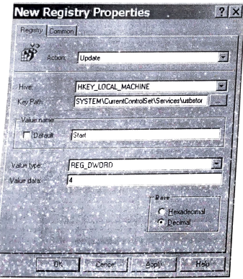

Slide 21
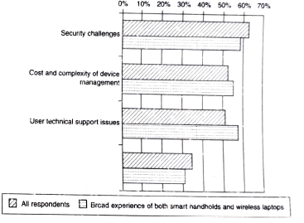

Slide 22
Managing the registry setting and configuration:
Even if the user go through every control panel setting and group policy option- no desired baseline security
So make additional registry changes that are not exposed to any interface: avoid “registry hacks”

Slide 23
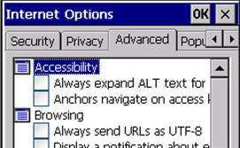
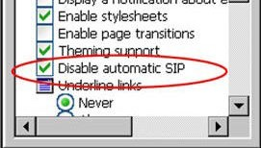
Example
When using Pick-IT ASP in Internet Explorer, the SIP (software input panel, or virtual keyboard) will pop up when a textbox is activated. We cannot control this panel through Pick-IT.
The method disables this SIP, depending on your mobile device model and operating system.

Slide 24
Authentication Service Security
Two components of security in mobile computing:
Security of devices
Security in Networks
  Involves mutual authentication between the device and the base station/ servers.
  Ensures that only authenticated devices can be connected to the network
  Hence, no malicious code can impersonate the service provider to trick the device.

Slide 25
Mobile Devices are subjected to following Attacks
Push attacks
Pull attacks
Crash attack

Slide 26
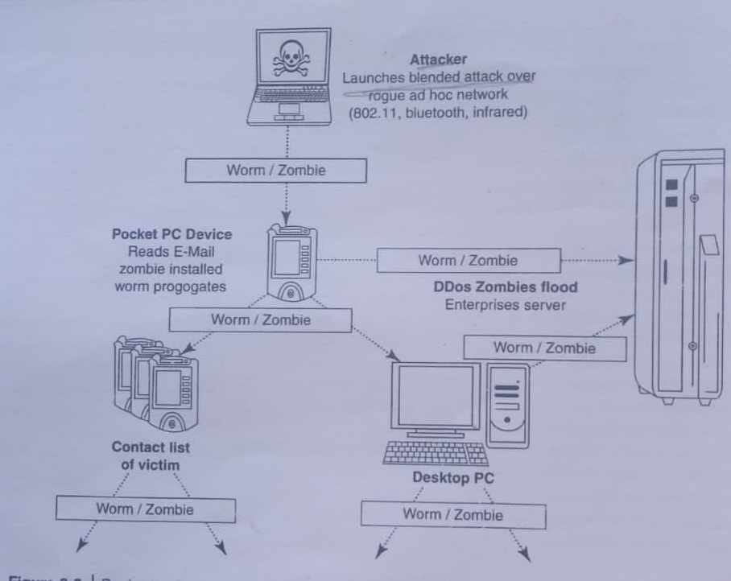
Push attacks
In push attack, the attacker creates a malicious code at the user's mobile device by hacking it and then he/she may spread it to affect other elements of the network.

Slide 27
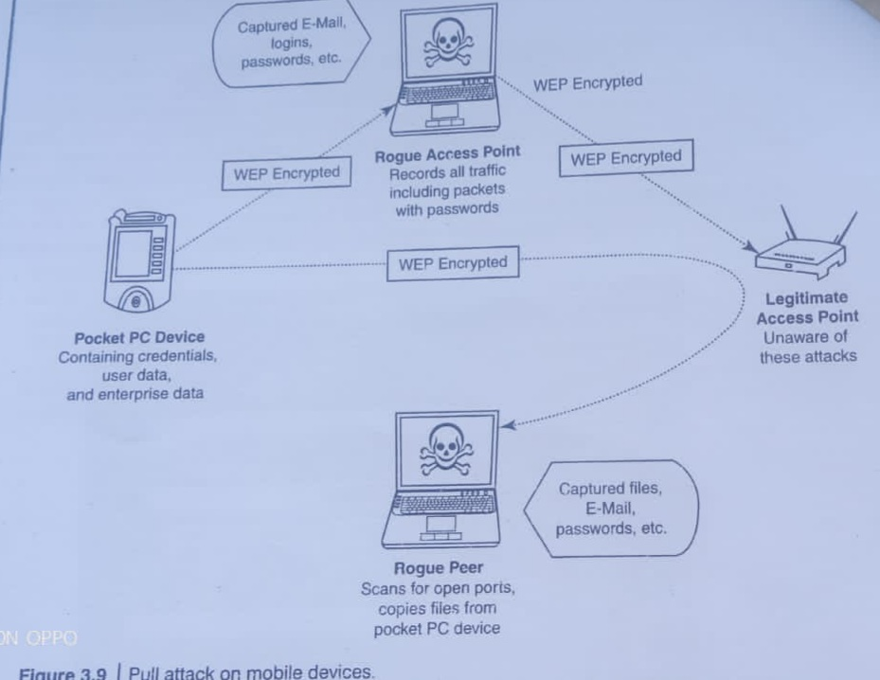
The pull attack
The pull attack is a type of attack where the attacker controls the device and handles it in his/her way. He can decide which emails they want to receive. In this attack, the user can decide about the obtained data by the device itself.

Slide 28
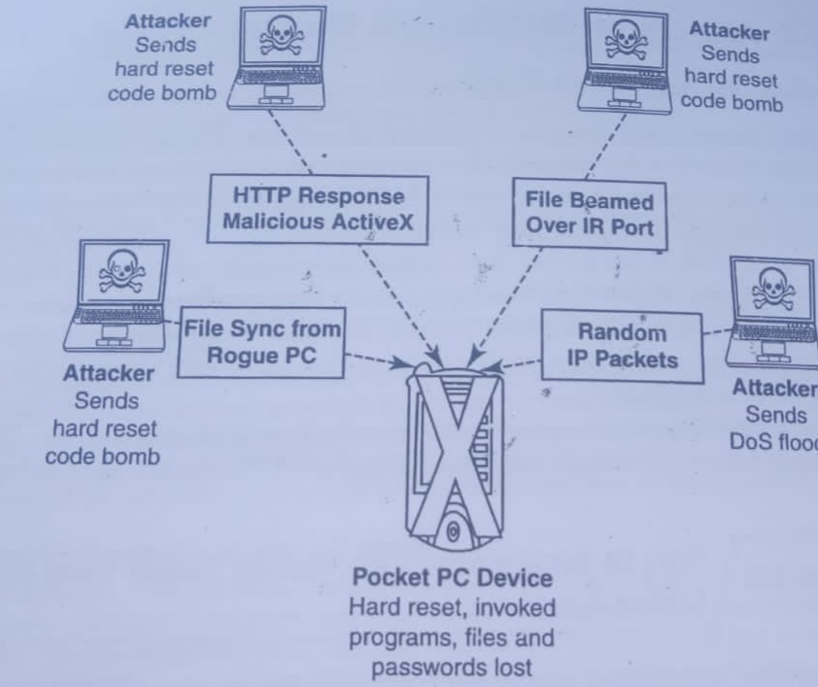
Crash attack

Slide 29
LDAP Security for Hand-Held Mobile Computing Devices
LDAP is a software protocol for enabling anyone to locate individuals, organizations and other resources such as files and devices on the network/ In a network, a directory tells you where an entity is located in the network. LDAP is a light weight (smaller amount of code) version of Directory Access Protocol (DAP) because it does not include security features in its initial version. Centralized directories such as LDAP make revoking permissions quick and easy. LDAP server is called – Dir. Systems Agent.
It includes : Root Dir., Countries, Organisations and depts., , and individuals

Slide 30
RAS Security for Mobile Devices
A remote access service (RAS) is any combination of hardware and software to enable the remote access tools or information that typically reside on a network of IT devices. A remote access service connects a client to a host computer, known as a remote access server.
RAS Includes : RAS Server, RAS Client and Data transmission protocols.

